Slide 1
Functions, Parameters and Variables
AP CSP Unit 4

Slide 2
Warm-up
For a long time now, since early in the missions, you have been encouraged to use functions in your code.
Definition of a function
Defining and calling a function
When to use a function

Slide 3
Introduction
A function is a procedural abstraction that manages complexity:
Functions can “chunk” code to make it easier to read and understand.
Functions hide the details of a task and give the task (section of code) a name.
Functions can be called repeatedly to avoid repetition.

Slide 4
Introduction
Since Mission 3, all of your programs have included at least one function.
Sometimes a function needed a parameter, and sometimes it didn’t.
Sometimes a function used variables that weren’t used anywhere else.
And sometimes – but not often – you had to use a global variable with a global statement.

Slide 5
Parameters
Many of the functions you used in your programs have parameters.
Parameter: information the function needs to complete the task.
Parameters make functions more flexible. You can use them for many different values and variables, instead of creating a function for every instance.

Slide 6
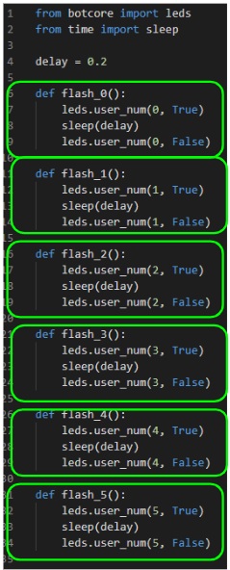
Parameters
In an early program, you defined functions for each user LED to flash on and off.
This improved the productivity of the program because the LEDs could flash in any order and multiple times.
However, there was a lot of repetition in the code.

Slide 7
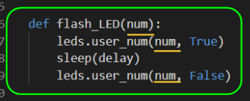
Parameters
So you used a parameter for the user LED to flash.
This was information the function needed to accomplish the task – flash a user LED.

Slide 8
Parameters
How do you know if a function needs a parameter? Here are some things to look for:
Is the variable part of a calculation?
Is the variable used in a condition (if statement or loop)?
Is the variable used as an argument for another function call?
These are all good reasons to pass information from the main program into a function.

Slide 9
Parameters and Local Variables
Sometimes the main program doesn’t have the information yet. Or a variable isn’t needed anywhere except in a function. Then the function can use a local variable.
Local variables are defined and used in a function. They can only be used within that function.
But you won’t need them anywhere else, so that is okay.

Slide 10
Parameters and Local Variables
Here are some reasons to use local variables in a function:
The value is being calculated and then used as an argument in a function call.
The variable is the counter in a loop: Loop Control Variable
Let’s look at some functions you wrote and identify the parameters and local variables.

Slide 11
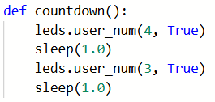
Parameters and Local Variables
Examples:
No parameters
No local variables
This function will do the exact same thing every time it is called.

Slide 12
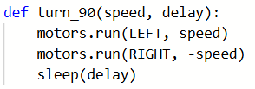
Parameters and Local Variables
Examples:
Two parameters
They are used as
arguments in function calls
No local variables
This function will turn at different speeds and duration, depending on the arguments in the function call.

Slide 13
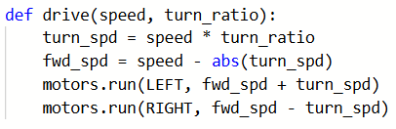
Parameters and Local Variables
Example #3:
Two parameters
They are used in calculations
Two local variables
They are calculated and then used as arguments in function calls.

Slide 14
Parameters and Local Variables
Activity
Go to your Activity Guide: Problems 1-5.
Review some functions you defined and used in your programs.
Identify parameters.
What are they used for?
Identify local variables.
What are they used for?

Slide 15
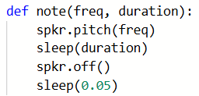
Parameters and Local Variables
Activity
Problem #1
Identify parameters.
What are they used for?
Identify local variables.
What are they used for?

Slide 16
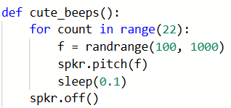
Parameters and Local Variables
Activity
Problem #2
Identify parameters.
What are they used for?
Identify local variables.
What are they used for?

Slide 17
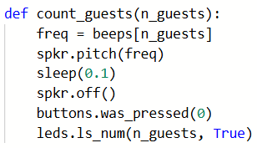
Parameters and Local Variables
Activity
Problem #3
Identify parameters.
What are they used for?
Identify local variables.
What are they used for?

Slide 18
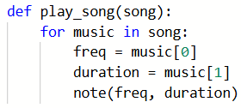
Parameters and Local Variables
Activity
Problem #4
Identify parameters.
What are they used for?
Identify local variables.
What are they used for?

Slide 19
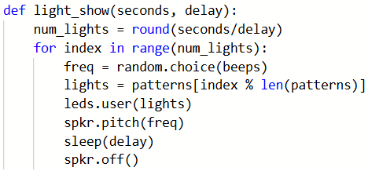
Parameters and Local Variables
Activity
Problem #5
Identify parameters.
What are they used for?
Identify local variables.
What are they used for?

Slide 20
Global Variables
Look at the last problem again.
Parameters: seconds, delay
Local variables: num_lights, index, freq, lights
But what about beeps and patterns?

Slide 21
Global Variables
beeps and patterns are used in calculations and as arguments, but they are never assigned a value! They are global variables.

Slide 22
Global Variables
Global variables are defined in the main program, outside a function.
They can be used throughout the program, anywhere, including functions.
Lists defined in the main program are global.
Since their scope is wide (entire program) they do not need to be passed into parameters.
They can be, however. It is not wrong to include global variables as parameters. And sometimes you will want to.

Slide 23
Global Variables
One more note about global variables – specific to Python.
Global variables can be used in any function at any time.
But if you change the value of the variable, if you update it, then you must let the computer know by using the global statement:
global threshold

Slide 24
Parameters, Local Variables and Global Variables Activity
Go to your Activity Guide: Problems 6-10. Review some functions you defined and used in your programs.
Identify parameters.
What are they used for?
Identify local variables.
What are they used for?
Identify global variables.
Are the values changed during the function? If so, was the global statement used?

Slide 25
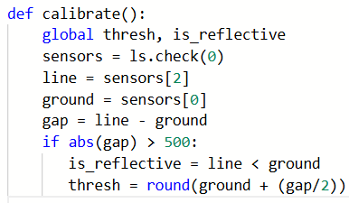
Parameters, Local Variables and Global Variables Activity
Problem #6

Slide 26
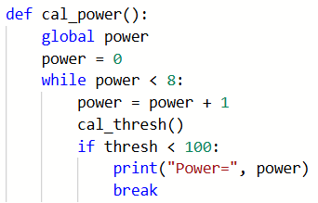
Parameters, Local Variables and Global Variables Activity
Problem #7

Slide 27
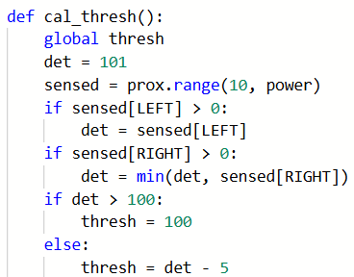
Parameters, Local Variables and Global Variables Activity
Problem #8

Slide 28
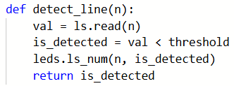
Parameters, Local Variables and Global Variables Activity
Problem #9

Slide 29
Parameters, Local Variables and Global Variables Activity
Problem #9
Let’s look at this function
more closely.
Parameters: n, used as an argument
Local variables: val, is_detected
Global variables: threshold
But what about the return?

Slide 30
Parameters, Local Variables and Global Variables Activity
Problem #9
is_detected is a local
variable. But the value
is used in another function.
You would need to make this variable global, or return the value to where the function is called.
The return statement passes the value to the function call, where it is then assigned to another variable, or used in a condition.

Slide 31
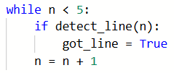
Parameters, Local Variables and Global Variables Activity
Problem #9
Look at the function call
to this function.
Do you see how it is using the return value in the if statement?

Slide 32
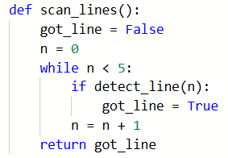

Parameters, Local Variables and Global Variables Activity
Problem #10
Function Call

Slide 33
Wrap Up
Programming is a creative process.
There isn’t just ONE right way to solve a problem.
One person might use a parameter, and another person might use a global variable, or even a local variable.
One solution might return a value, and another might use a global variable instead.
The choice is yours!
Complete the wrap-up questions in the assignment.

